Slide 1
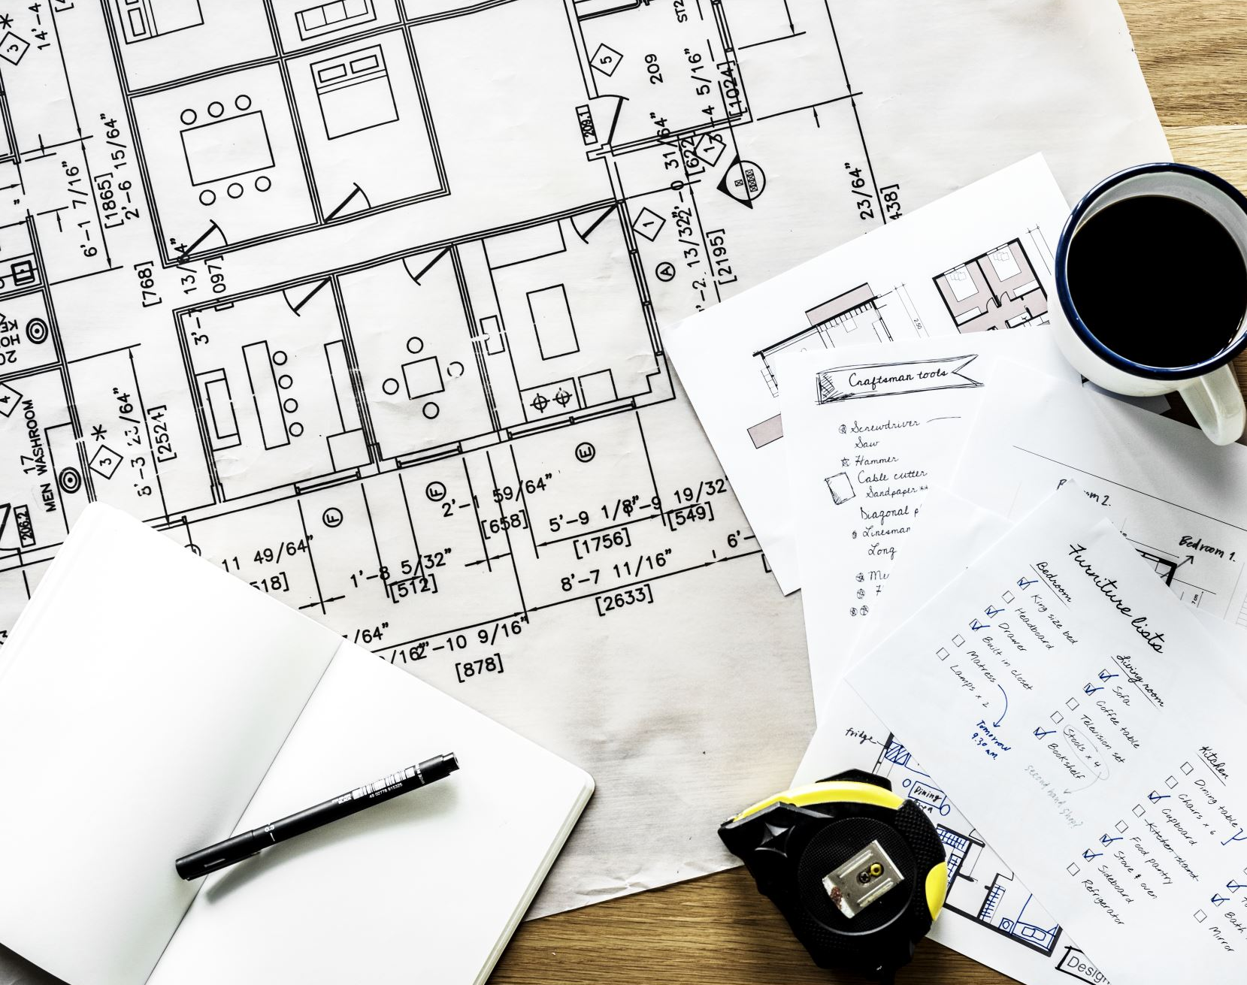
Media Planning Blueprints
Create unique media plans for each product and service using this tip.

Slide 2

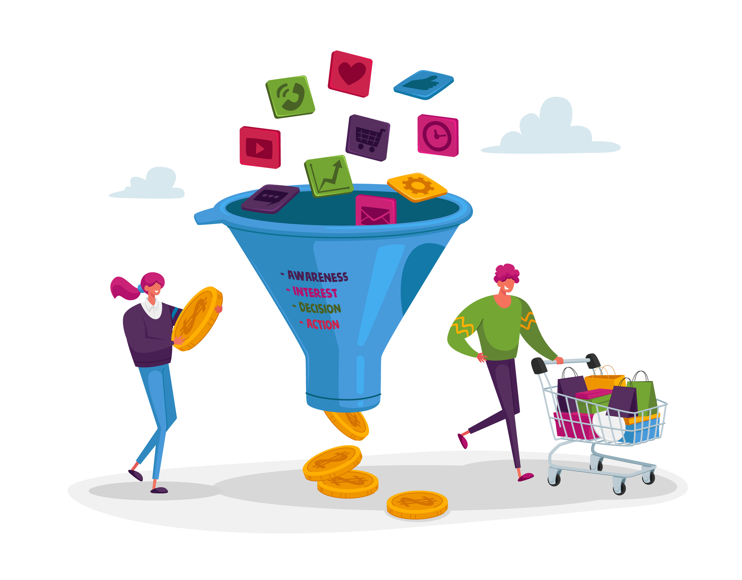
Intro
Whether you are advertising to sell products and services, or to let people know about your business, you will need to create media plans for each campaign. Here is my tip for an easy to follow and effective way to create your media plans.
First let us agree that in Social Media and Google Ads all campaigns would fall under three distinct categories, Awareness, Consideration, and Conversion. However, the definition and ad manager design changes from one platform to another. For the sake of demonstration, we will use these 3 categories, but each business can change/add to them as they see fit for the needs.
Awareness | Consideration | Conversion

Slide 3
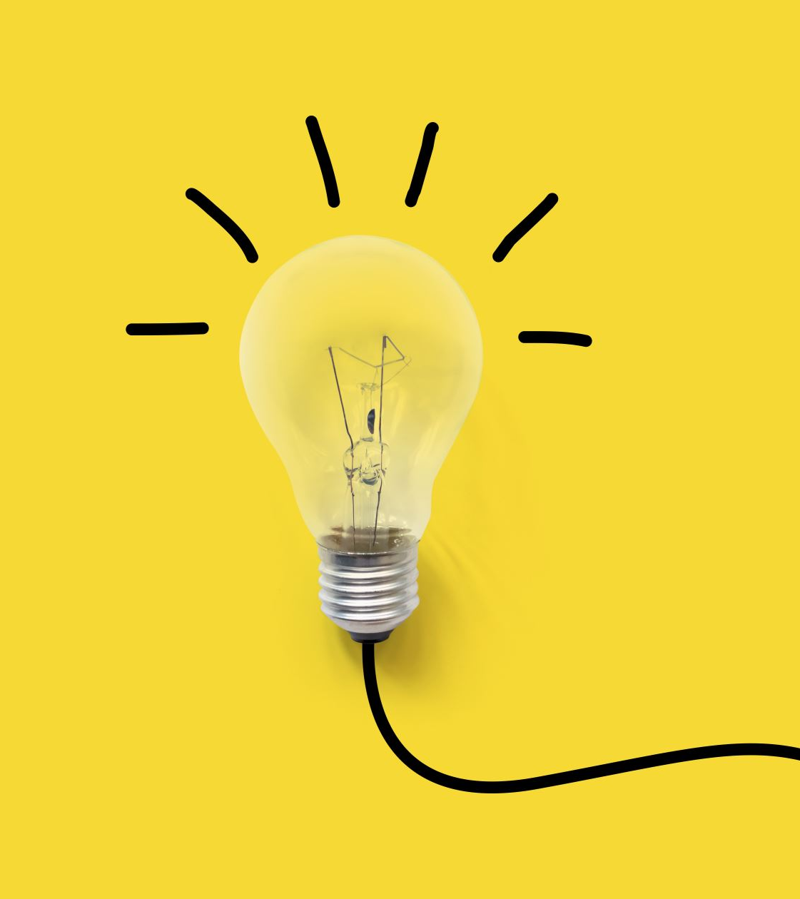
Awareness Campaigns
Awareness campaigns with the goal of Reach and Frequency are to create a brand or product awareness among our target audience. This is an effective way to introduce a new brand or product and service, or to make an announcement and to get new followers.

Slide 4
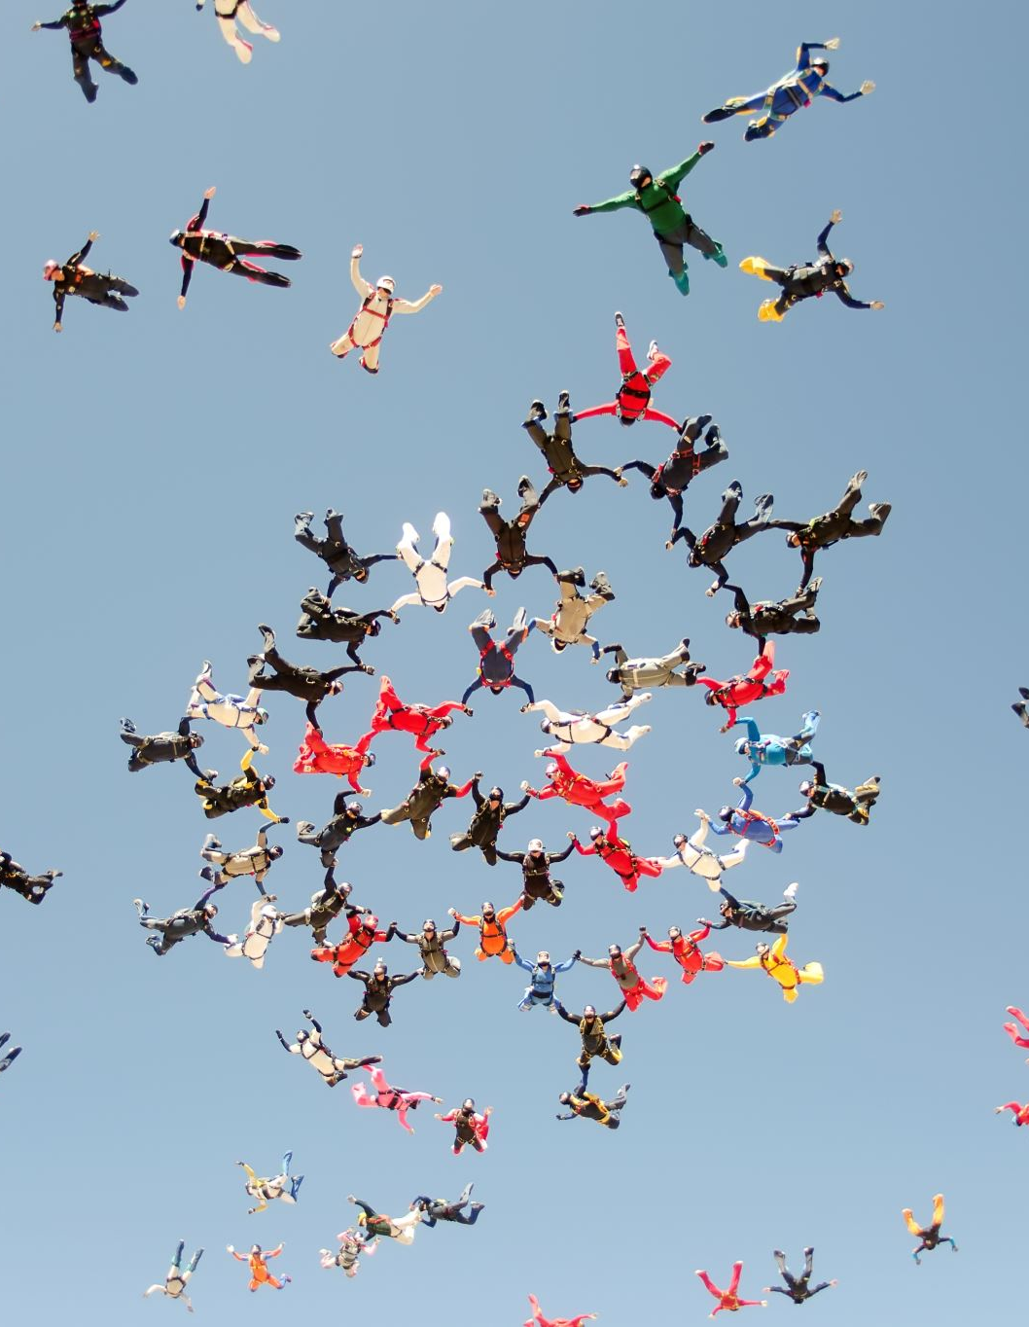
Consideration Campaigns
Consideration campaigns are usually a follow up campaign, especially on social media, and we also see it in Teaser campaigns on TV & OOH. The goal of these campaigns is to encourage your existing and potential customers to engage with your brand and service in specific ways, such as, sharing, liking, and commenting on your social posts, and to engage the community in a dialogue discussing your message. This will help keep your customers update to date with you, appreciating your business and services, and potentially encouraging further actions like sales and registrations.

Slide 5


Conversion Campaigns
The conversion type of campaigns is purely transactional based. The campaign setup especially on the targeting mechanism and content design/details is to help the business achieve business results, such as sales, registration, app downloads, and subscriptions.

Slide 6

Business Needs
Second, we tend to sell more than one product and service, and we do add new ones every now and then. This means that we will eventually have to launch multiple advertising campaigns with different objectives.
Therefore, it is extremely helpful and cost effective to have our unique references that suits our business, to minimize the trial-and-error situations, and to make the creation of media plans process smoother and quicker. Let us call this our own Blueprints.

Slide 7
The ideal Blueprints Model
The following blueprint’s model is highly effective to use no matter what type of business you are in and for all types of campaigns you need to launch.
It allows you to add new brands and services while maintaining the same media deliverables that you define.
New Brand | Existing Brand | New Product | Existing Product
Small Campaign
Medium Campaign
Big Campaign

Slide 8

Populating your data into the Blueprints
Start populating each table with the best media plan requirements for each campaign objective (Awareness, Consideration, Conversion). These requirements should cover the following areas:
Media mix: what is the best combination you can use to achieve your goals?
Media deliverables: what is the result that we will get from each medium?
Media performance: what is the outcome of each medium deliverables?
Budget: What is the total budget and breakdown by medium?
Campaign duration: what is the ideal duration for this type of campaign?
Creative format: what is the best creative format for this type of campaign?

Slide 9
Blueprint Model
Paid Media Campaigns Blueprint Model |  | Awareness | Consideration | Conversion
 |  | Media Mix, Creative Format, Buying Model, Campaign Duration, Budget, Deliverables | Media Mix, Creative Format, Buying Model, Campaign Duration, Budget, Deliverables | Media Mix, Creative Format, Buying Model, Campaign Duration, Budget, Deliverables
New Product/Service | Small
 | Medium
 | Big
Existing Product/Service | Small
 | Medium
 | Big

Slide 10
Blueprint – Template Sample (Summary)
Paid Media Campaigns Blueprint Template |  | Awareness
Product/Service Type | Campaign Size | Media Planning Blueprints
New Product/Service | Small | Media Mix | Creative Format | Buying Model | Campaign Duration | Budget | Goals
 |  | Social Media | 30 Seconds Video and/or Photo Post | CPV/CPM | 4 Weeks | 350,000 S.R | 60% Reach 3 Frequency Cap

Slide 11
Final Step
The best way to develop these blueprints is by looking into and reviewing your previous paid advertising campaigns. When running your first advertising campaign, you might need to consider your organic advertising results, as well as marketing research data.
Once you build your Blueprints, it is time to create a media plan template for each scenario (Excel sheet), where you include the exact numbers for each medium.

Slide 12
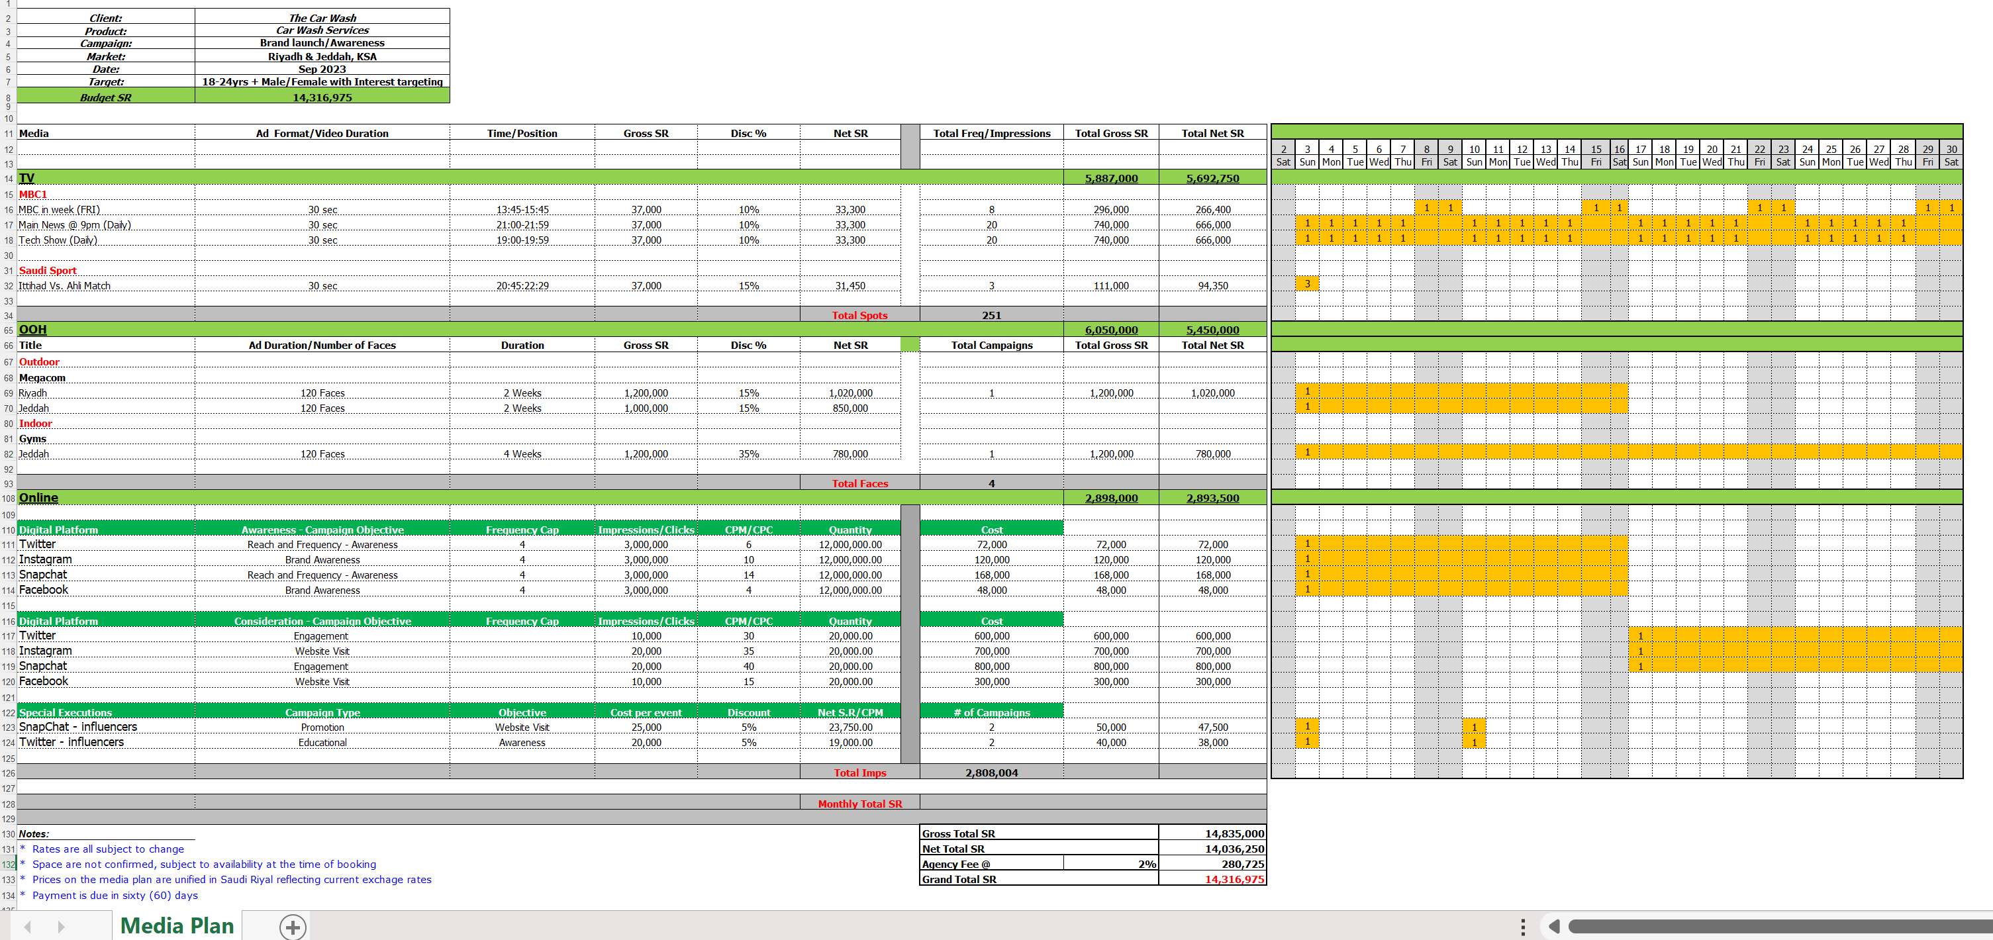
Blueprint – Template Sample (Detailed)

Slide 13


Conclusion
Finally, Blueprints are useful to create media references that are specific for your needs. Nevertheless, you need to be creative and trying to add new medium, execution, or creative where and when possible, stay up to date with latest media trends and opportunities in the market.
By following these practices, you will always get the best results and be able to optimize your media budget on each campaign.

Slide 14

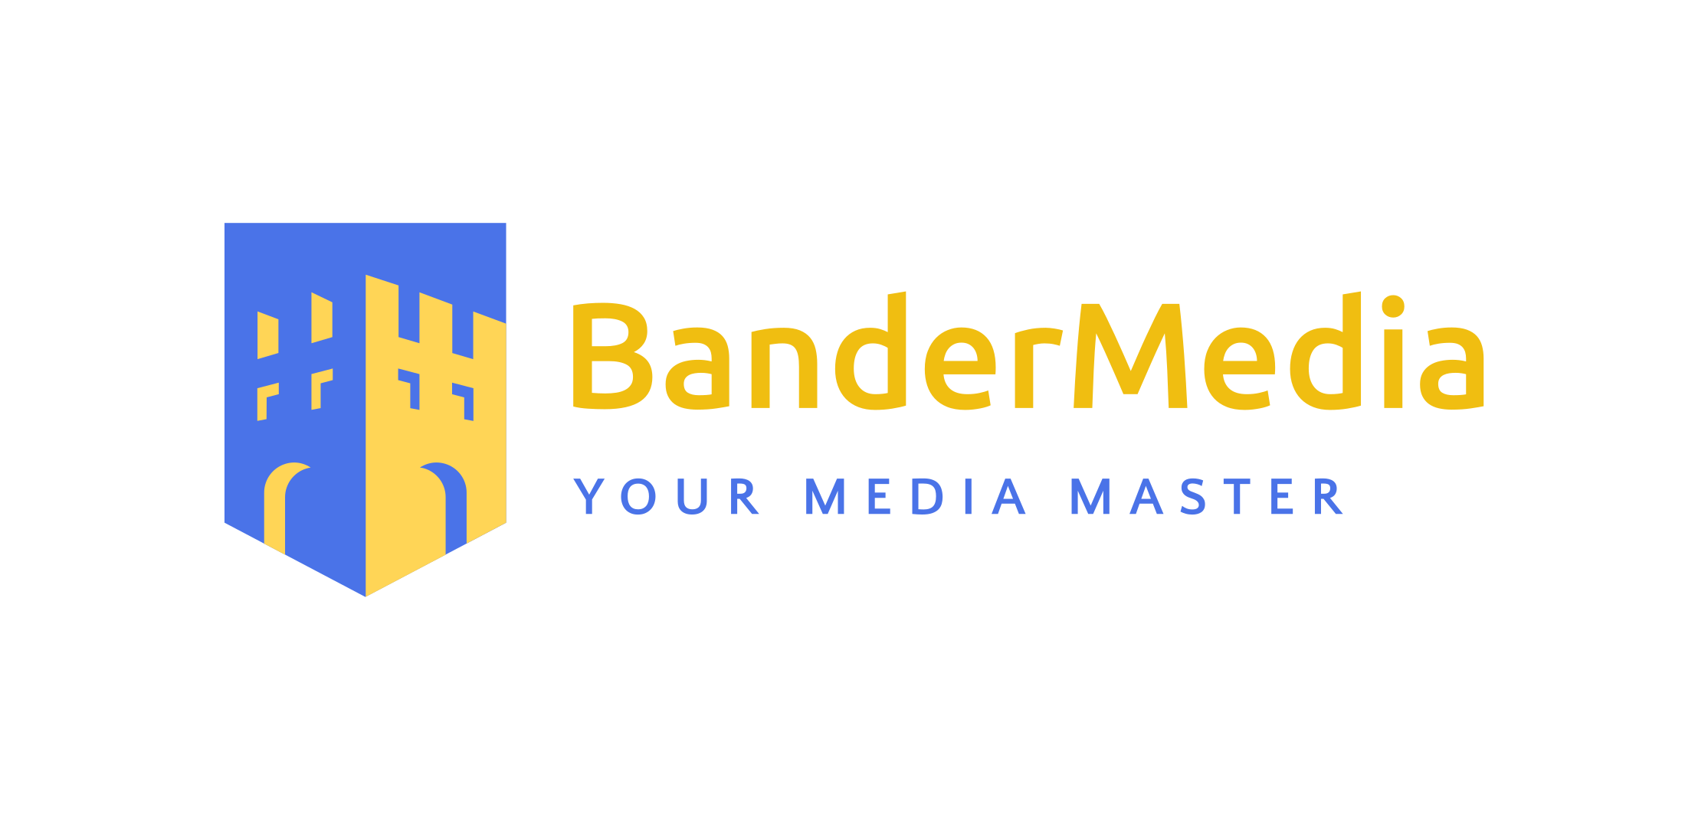
That’s all
Contact us for more details and special proposals @
Master@bandermedia.com

